Slide 1
Open Studio Project
Energy and Environmental Technologies for Building Systems
Federico Genco
Guglielmo de Vanna
Federico Riva

Slide 2
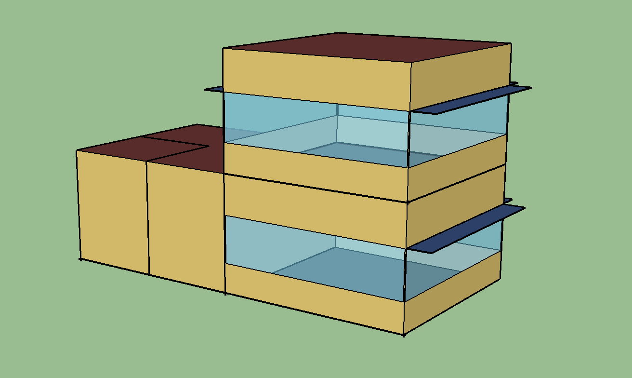
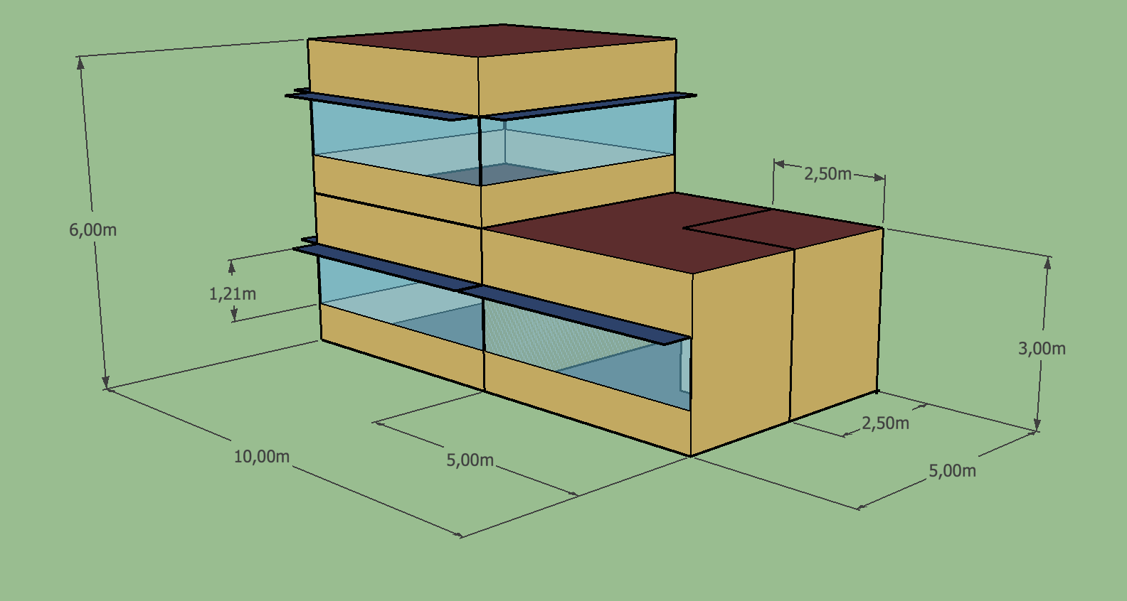
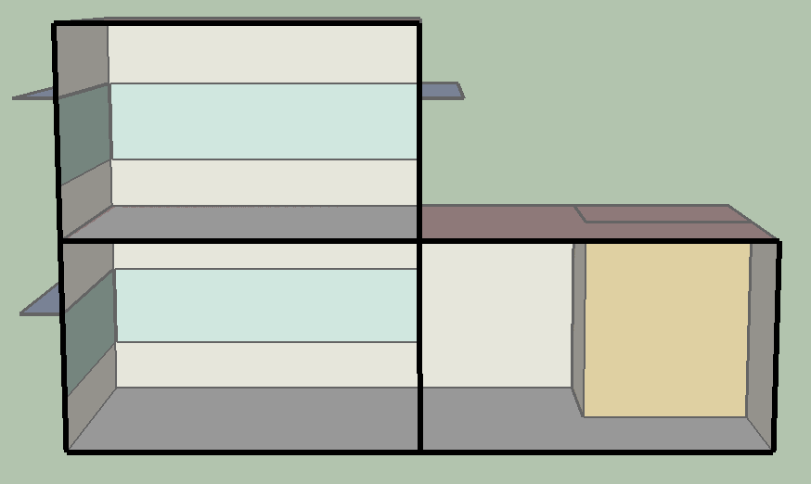
Building characteristics
The building investigated is a small business building formed by three rooms and a restroom distributed over two floors.

Slide 3
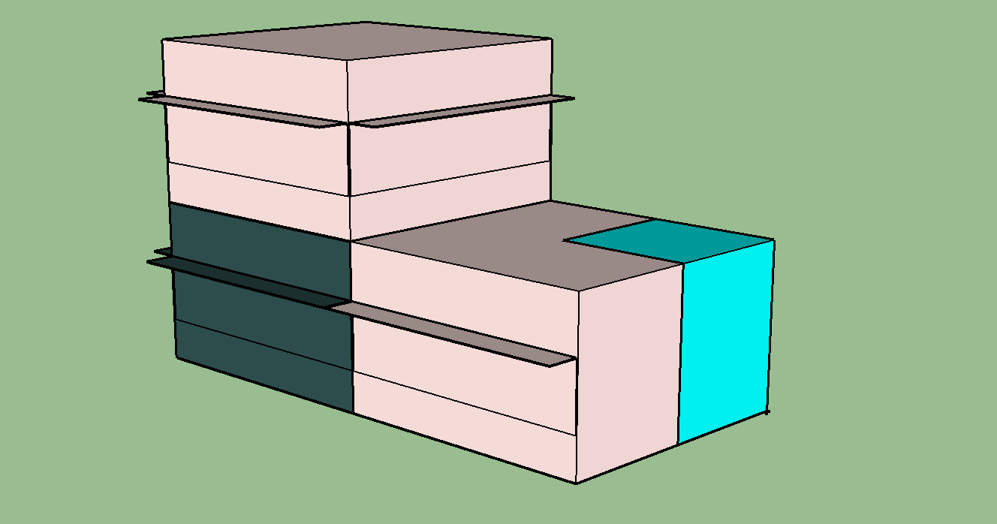
THERMAL ZONES
The house is divided into three different thermal zones, based on the purpose they serve.
Thermal zone 1: lobby
Thermal zone 2: breakroom
Thermal zone 3: restroom

Slide 4
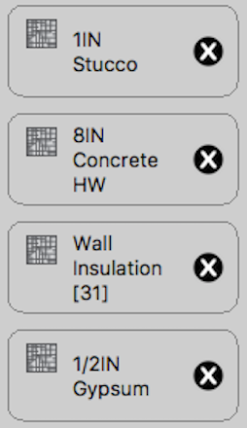
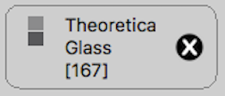
BASE CASES
The base cases we decided to analyse are located in:
Piacenza
Palermo
London
Wall layers
Windows layers

Slide 5
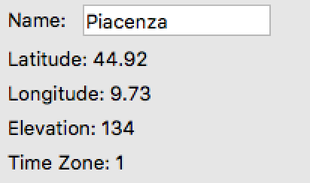
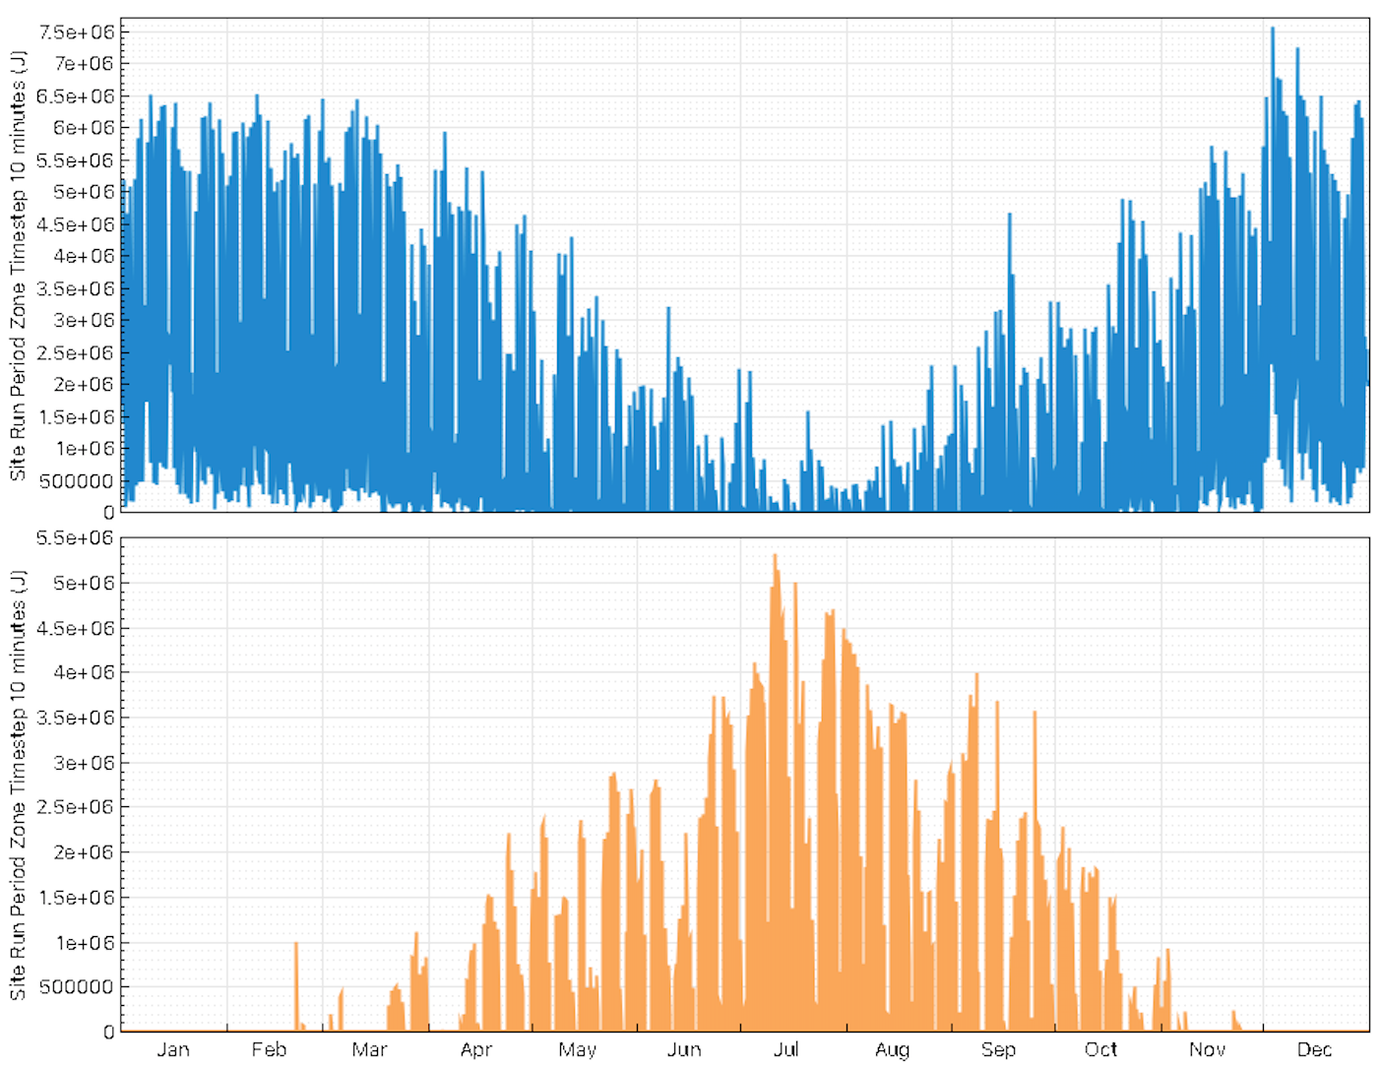
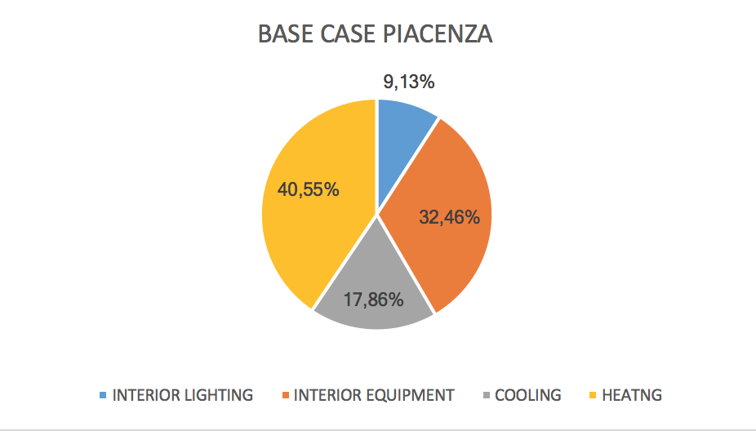
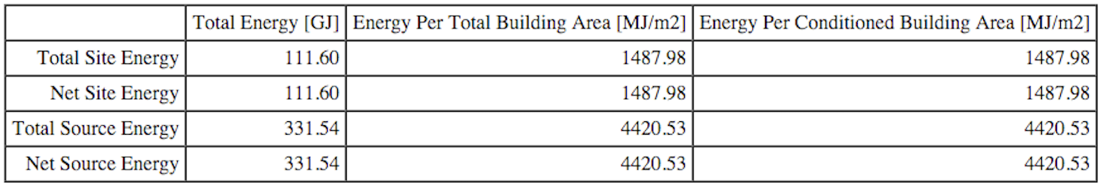
BASE CASE PIACENZA (ITALY)

Slide 6
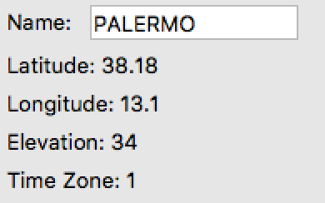
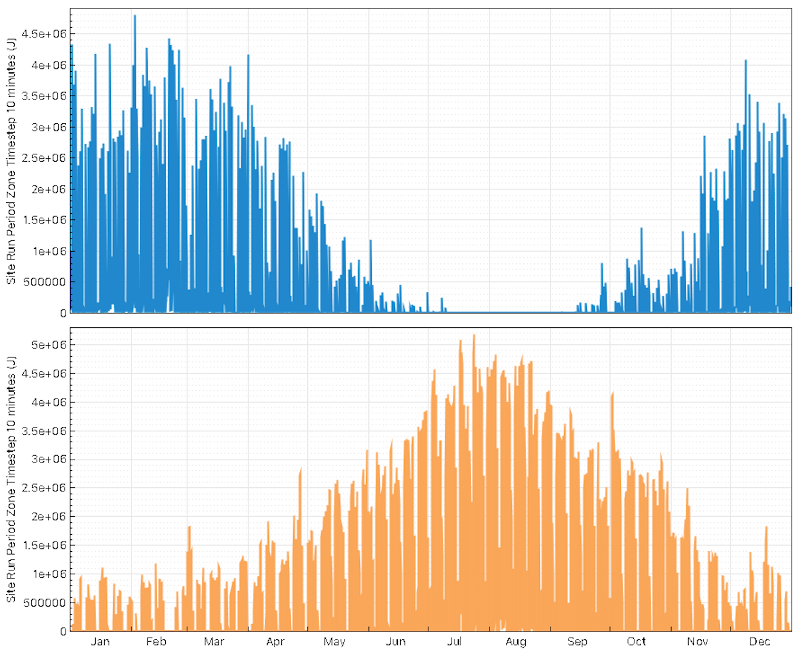
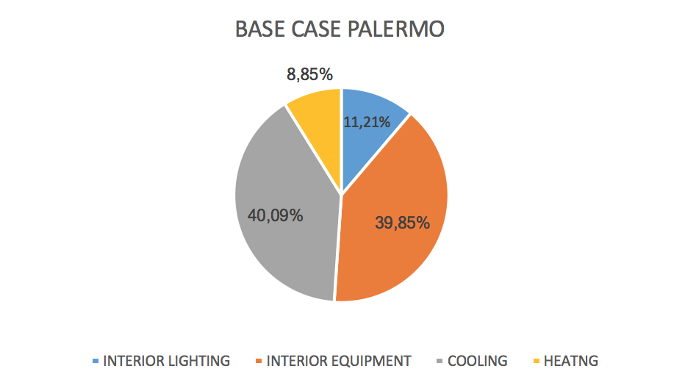
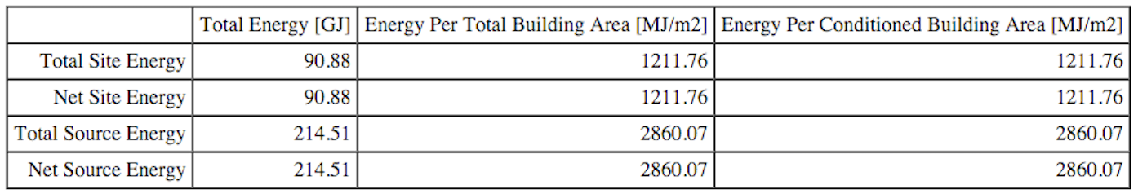
BASE CASE palermo (ITALY)

Slide 7
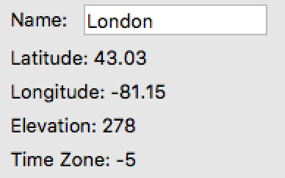
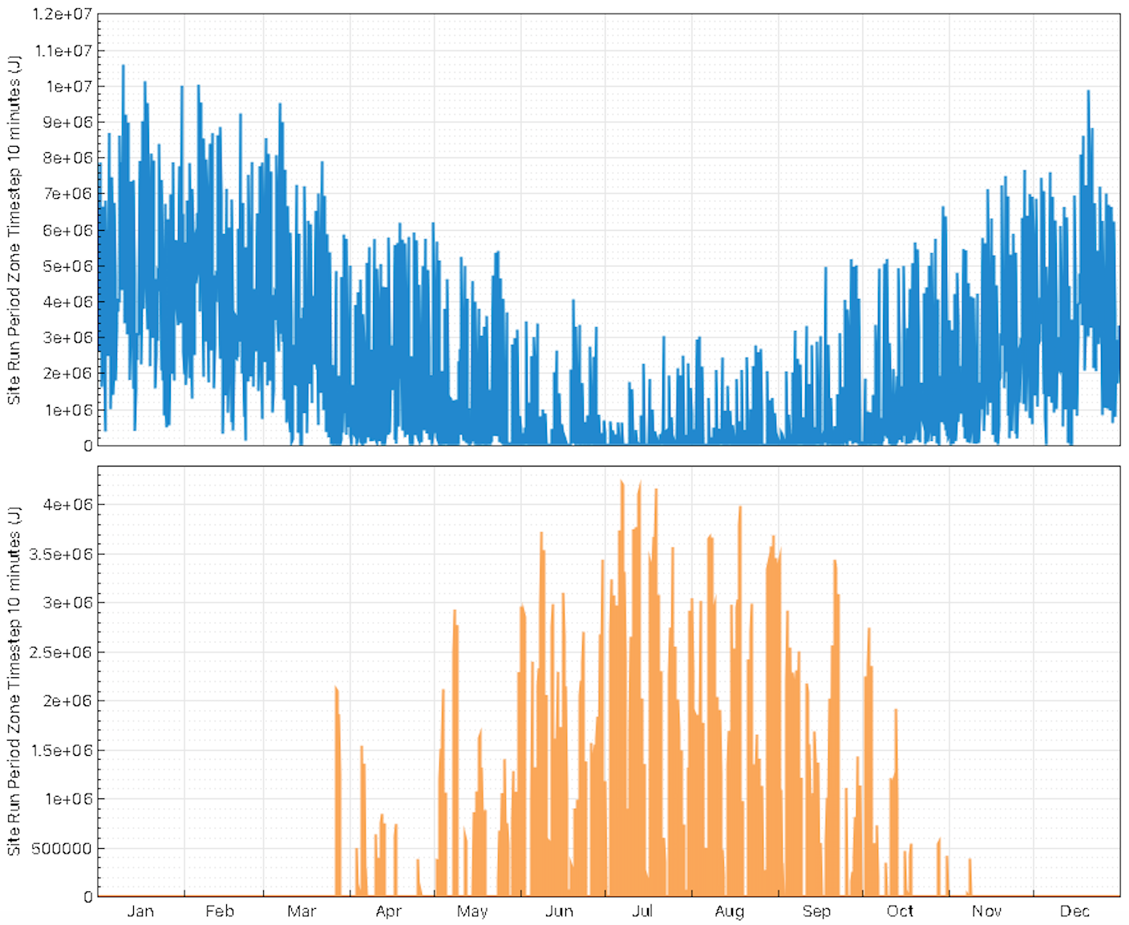
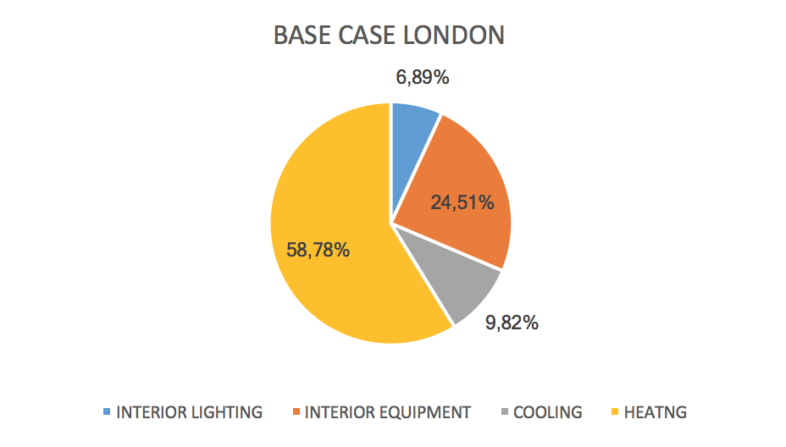
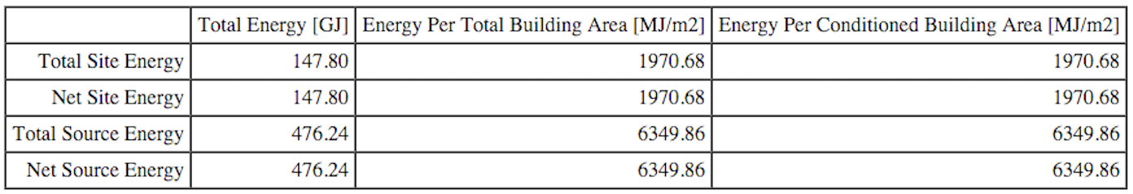
BASE CASE london (uk)

Slide 8
SUMMARY
LOCATION | HEATING [ GJ ] | COOLING [ GJ ]
PIACENZA | 45.25 | 19.93
PALERMO | 8.04 | 36.43
LONDON | 86.88 | 14.51

Slide 9
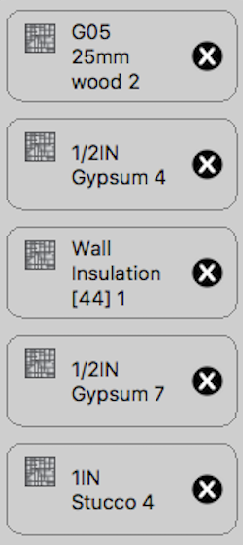
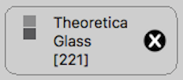
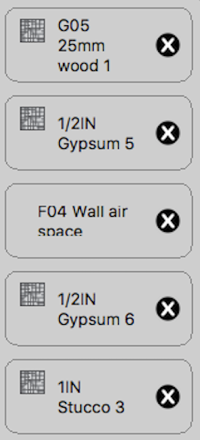

Best/worst case
Following the energy consumption analysis of the house located in the three different places, we focused on the energy consumption of the house placed in Piacenza, considering two opposite wall and window conditions: best case and worst case.
Best case:
Worst case:
Wall layers
Windows layers
Wall layers
Windows layers

Slide 10
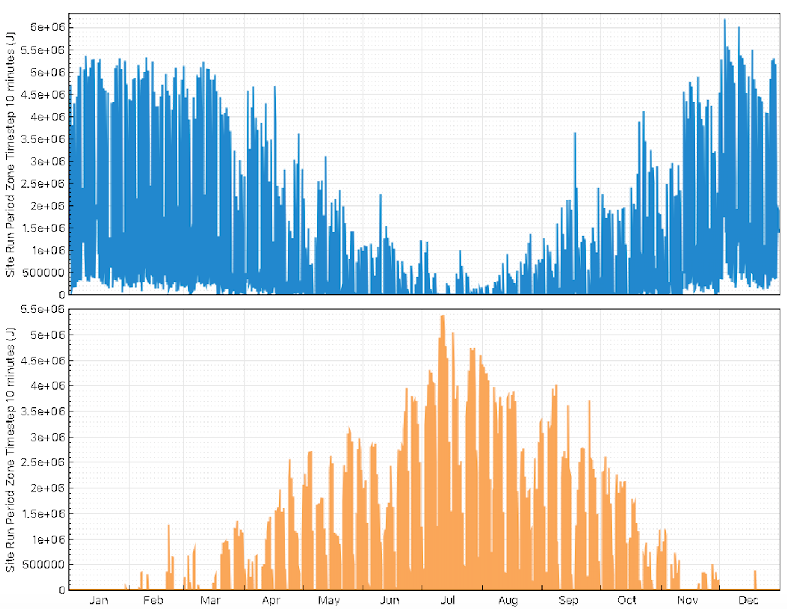
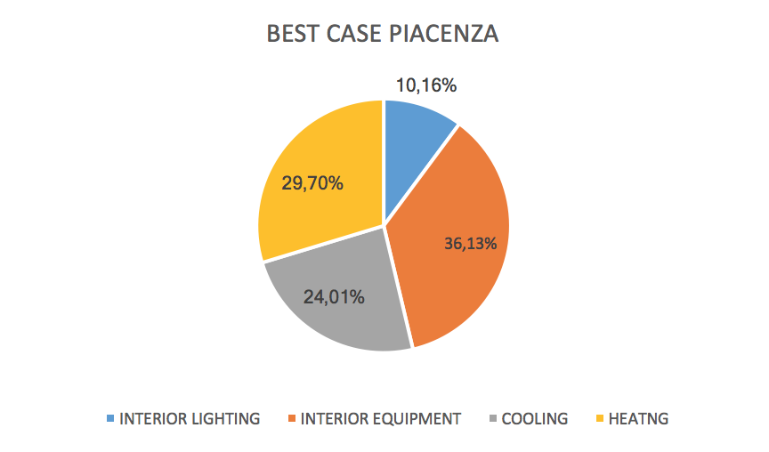
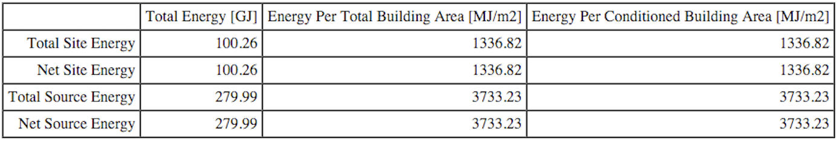
Best case PIACENZA

Slide 11
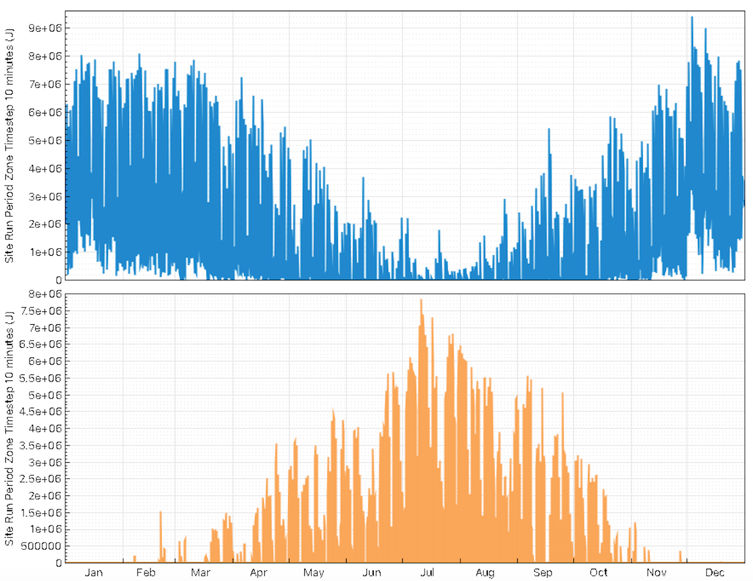
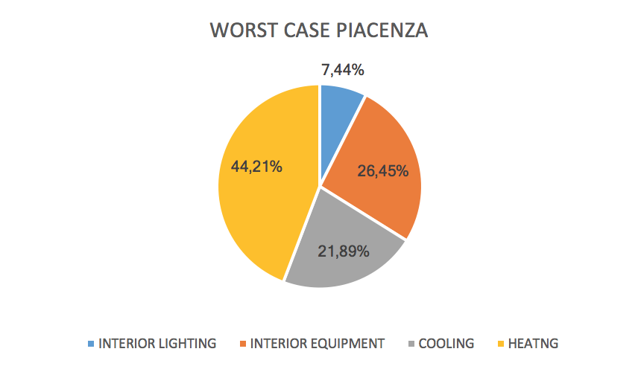
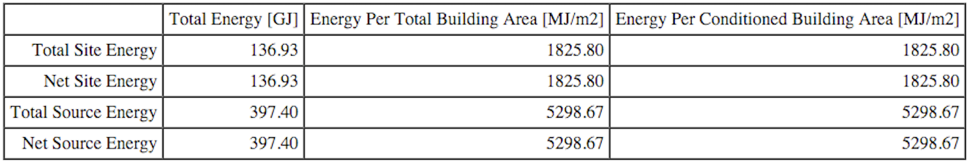
WORST case PIACENZA

Slide 12
SUMMARY
CASE | HEATING [ GJ ] | COOLING [ GJ ]
BEST | 29.77 | 24.07
WORST | 60.54 | 29.98

